Slide 2
Security for The Machine – A sneak peek at security research from HP Labs
Pratyusa K. Manadhata / June 3, 2015
#HPDiscover

Slide 3
Please give me your feedback
Session DT1329 Speaker Pratyusa Manadhata
Use the mobile app to complete a session survey
Search for the app in your app store: HP Discover
Access “My agenda”
Click on this session
Go to “Rate & review”
If the session is not on your schedule, just find it via the session catalog, click on this session and then go to “Rate & review.”
Thank you for providing your feedback to help us enhance content for future events.

Slide 4
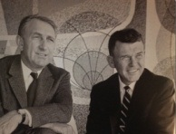
HP Labs: engine of innovation
1980
Office laser printer
2001
Utility data center
2012
StoreAll
OpenFlow
switches
1967
Cesium-beam atomic clock
1984
Inkjet printer
2002
Rewritable DVD for standard players
1972
Pocket
scientific calculator
2010
ePrint
2014
Location aware
Trafodion
DNS logging
QoS controller
3D printing technology
1986
3D graphics workstations
1994
64-bit
architecture
1966
1980
64-channel ultrasound
2011
MagCloud
3D photon
engine
StoreOnce
2013
Moonshot
Threat central
SureStart
1989
Digital data
storage drive
1975
Standard for interface bus
2005
Virus throttle
2015
Distributed R
1968
Programmable desktop calculator
1986
Commercialized RISC chips
2003
Smart cooling
1999
Molecular Logic Gate
1966
Light Emitting Diode (LED)
Notes:
One of the most popular questions I and my Lab Directors get is “What’s Labs done for us lately?”
Successful technology transfer is a key focus for us, and an important part of how we interact with the HP business units and ultimately HP customers. Here are a few of our more recent results.
2010 ePrint -- 30 years ago, HP introduced Printer Command Language so PCs can talk to printers; ePrint lets you use any Web-connected printer anywhere. Take a photo on vacation and send it so it comes out of the printer at your Mom’s house -- easily without inputting IP addresses.
2011 MagCloud pioneers a new era of self-service printing and distribution, where anyone can affordably turn content into professional publications in print or digital format. This technology has been used to create communications – many of them award-winning – that capture a moment and are ready in an instant.
2011 Pluribus/3D Photon technology: Immersive 3D that combines innovations in screen technology, software, and camera equipment so realistic that some viewers have tried to walk through the screen.
2011 Memristor. I mentioned Memristor earlier -- bringing this kind of breakthrough to market can typically take 15-20 years. HP is working with Hynix Semiconductor to commercialize memory chips with memristor technology to deliver a replacement for flash memory.
2012 Project Moonshot: revolutionary new way to build servers based on low-powered chips with ARM or Intel Atom architectures, like those in cell phones and other mobile devices. Reduces costs by 50%, cut power consumption by nearly 90%, and reduces footprint of a server group by 80%.
These successful transfers – and many more currently in the pipeline – are examples of how HP Labs is continuing a 45-year record of achievement…and driving the HP reputation for innovation into the future.
Thank you.
HP Labs was formed over 45 years ago to give HP’s researchers a protected environment in which to do blue-sky research. This helps to avoid the Innovator’s Dilemma. The result is a series of remarkable breakthroughs.
Many people know HP as an iconic American company started by Dave Packard and Bill Hewlett.
They know us by the famous garage that came to symbolize the most celebrated and productive concentration of innovation anywhere: Silicon Valley.
HP’s reputation is the result of 75 years of innovation, featuring over 45 years of achievement on the part of HP Labs.
1968: First programmable scientific desktop calculator. Virtually the first PC, the HP 9100A solves science and engineering problems 10x faster than other machines.
1972: First pocket scientific calculator, the HP-35 that fits in a shirt pocket.
1984: HP launches its first inkjet printer. Based on thermal inkjet technology from HPL, the ThinkJet is high-quality, low-cost and much quieter than noisy dot matrix models.
1986: HP is first to commercialize Reduced Instruction Set Computing. RISC is faster and more productive than previous generations of chips.
1999: HP and UCLA build first molecular logic gate, a key step in creating chemically assembled electronic nanocomputers.
2002: HPL creates technology for first rewritable DVD system (DVD+RW) compatible with standard DVD players.
Successful technology transfer is a key focus for us, and an important part of how we interact with the HP business units and ultimately HP customers. Here are a few of our more recent results.
2010 ePrint -- 30 years ago, HP introduced Printer Command Language so PCs can talk to printers; ePrint lets you use any Web-connected printer anywhere. Take a photo on vacation and send it so it comes out of the printer at your Mom’s house -- easily without inputting IP addresses.
2011 MagCloud pioneers a new era of self-service printing and distribution, where anyone can affordably turn content into professional publications in print or digital format. This technology has been used to create communications – many of them award-winning – that capture a moment and are ready in an instant.
2011 3D Photon Engine technology: Immersive 3D that combines innovations in screen technology, software, and camera equipment so realistic that some viewers have tried to walk through the screen.
2011 StoreOnce: HP StoreOnce deduplication and HP StoreOnce Catalyst— using a single deduplication engine designed at HP Labs—deliver the first federated deduplication solution in the industry. Our more efficient approach optimizes backup processes, eliminates wasted resources, reduces network bandwidth costs, and improves backup throughput.
2012 StoreAll with Express Query: HP’s revolutionary hyperscale storage platform provides massive scalability and structure to unstructured data, with Express Query from HP Labs, that lets you access billions of files in minutes.
2013 Project Moonshot: revolutionary new way to build servers based on low-powered chips with ARM or Intel Atom architectures, like those in cell phones and other mobile devices. Reduces costs by 50%, cuts power consumption by nearly 90%, and reduces footprint of a server group by 80%.
2013 HP SureStart: a first of its kind technology that helps businesses protect against malicious attacks or malfunctions. The product of a long-standing collaboration between HP Labs and HP’s Business PC division, HP SureStart works with HP BIOSphere, the company’s industry-leading firmware ecosystem, to automatically restore a system’s BIOS firmware to its previously safe state if attacked or corrupted.
These successful transfers – and many more currently in the pipeline – are examples of how HP Labs is continuing a 45-year record of achievement…and driving the HP reputation for innovation into the future.

Slide 5
HP Labs charter Delivering innovations that transform business, life, and society
Deliver breakthrough technologies
Create opportunities for our business and customers
Advance fundamental science
Engage with customers and partners
Notes:
Where do we innovate to bring value and when to we leverage the broader ecosystem?
When do we go deep? When we’re the only ones
When do we leverage? When building on the work of others brings better results

Slide 6
The Machine: HP’s answer to today’s data explosion problem
It will be able to compute much faster with huge amounts of data.
And, it will also take up a lot less space and pull a lot less energy.
Notes:
What is the machine? What does it do?

Slide 7


The Machine architecture
Photonics
Special purpose cores
Massive memory pool
Notes:
How does it do it?
---
This is what we’re building.
SoC, universal memory and photonics are the key parts of the architecture of the future
With this architecture, we can ingest, store and manipulate truly massive datasets while simultaneously achieving multiple orders of magnitude less energy/bit

Slide 8
Security for The Machine
It will be able to compute much faster with huge amounts of data.
And, it will also take up a lot less space and pull a lot less energy.
It will be much harder for bad guys to break into the machine,
see what’s inside, destroy anything or steal anything.
Notes:
What do we mean by security for the machine? What does it mean for the customer or end user?
--
It certainly doesn’t cover all the security work we do. But I wanted to keep it simple in the beginning, and accessible to a general audience without any background in security.

Slide 9
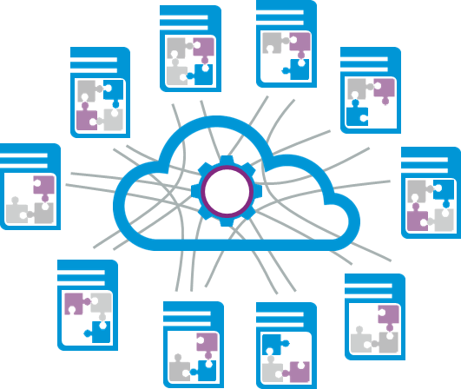
Challenges in securing The Machine
Security is always a challenge, but much more in the context of The Machine
Scale
New architecture
Vanishing control points
Performance bottleneck
Resource constraints
Notes:
Many components to secure
New architecture brings new security problems
OS control points may vanish
Security cant slow down operation
Hard limits on power envelopes and energy usage

Slide 10

A Security framework
Protect
Detect
Recover
Notes:
The labs PDR story, to be consistent across all types of messaging, including the demo

Slide 11

The ‘Protect-Detect-Recover’ framework…
Protect
Difficult to get inside, see anything inside, steal anything
Recover
Detect
Difficult to destroy
anything
Difficult to stay inside, steal anything
Notes:
What do PDR provide (relating to the initial slide)

Slide 12
…designed from the ground up...
Workload
Application
Data
Middleware
System software
OS
Platform
Hardware
Firmware
Notes:
Security built into all layers, top layers depend on mechanisms in the bottom layers

Slide 13
…with built-in primitives...
Workload
Security Information and Event Management (SIEM), Proxy, ..
Application
Data
Middleware
System software
OS
Platform
Hardware
Firmware
Notes:
Some mechanisms are inside the machine. Some others will be outside– e.g., SIEM, DLP, AV, and other network based protection wont go away. But we can build the machine in a way to interact with these systems better. For example, better event generation for SIEM.

Slide 14
…and the following goals.
Resilient
Scalable
Manageable
Efficient
Notes:
Scalable – scales to all architectures
Efficient – security doesn’t slow downs functionality, uses less energy
Resilient – hard to circumvent
Manageable – easy to deploy and manage

Slide 15
Technology
Ubiquitous
Emerging
Research
New
Access control
Disk encryption
Firmware protection
Hardware isolation
Notes:
For every layer in the stack and for P, D, R, we are looking at techniques that are
Ubiquitous – currently present in all systems, e.g., access control
Emerging – not widely adopted, e.g., firmware recovery
Research – still in research, e.g., think of something later
New – techniques that we need to come up with for the new architecture, e.g., SoC level isolation

Slide 16
Protect: Prevent malicious actions
Some examples are:
Run time monitoring
Access control
Data protection: low energy encryption
Integrity protection: secure boot and firmware
Notes:
Give some examples of protection we are thinking about. Tell them WHAT we plan to do, but not HOW we do it.

Slide 17
Protect: Access control at different layers
Application thread
Application thread
Application thread
Data object
Data object
Data object
OS
Application thread
Application thread
Application thread
Data object
Data object
Data object
Platform
OS
Notes:
Which SoC accesses which memory (memory broker)
Traditional OS level access control on each SoC

Slide 18
Protect: Data protection
Data at rest
Data in motion
Data in use
Notes:
Encryption of NVM
Encryption/integrity on the fabric
Process isolation and access control in OS

Slide 19

Detect: Detect malicious actions
Some examples of detection “in The Machine”
Detect firmware and kernel tampering
Runtime monitoring for malware detection
Monitoring for data leakage
Detect compromised/ malicious hardware components
Notes:
Some examples of detection. Via monitoring/inspection. The key message is monitoring has to be tamper proof.

Slide 20

Detect: Tamper-proof monitoring/introspection
Secure mode
Normal mode
Operating System
01101011011101111100001100011101110011110011011100011
Monitor
Hardware and firmware
Notes:
Need a better picture

Slide 21
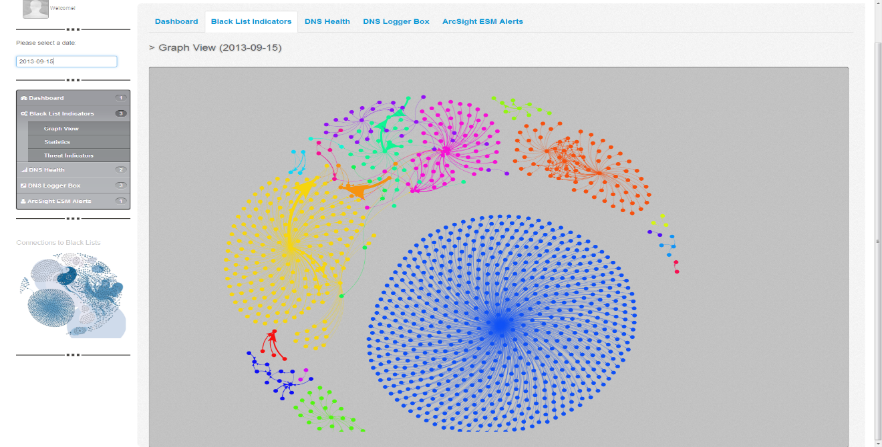
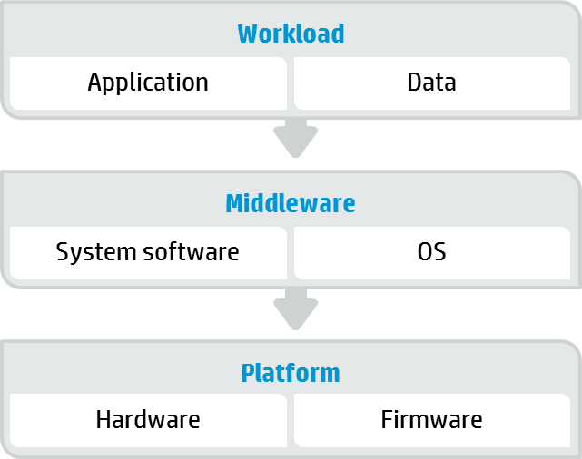
Detect: Primitives to enable detection “outside The Machine”
Primitives/APIs for event generation and remediation/recovery action
DNS Analytics
Notes:
Some detection will happen outside the machine. How do we facilitate that. For example, how do we generate events and send them to the analytics system? How does the analytics system communicate remediation action to the machine? We are thinking about building APIs to facilitate these.

Slide 22
Recover: Recover from malicious actions
Some examples are:
OS, application, and data recovery
Systematic recovery at scale with minimal human intervention
Recovery at the firmware layer

Slide 23
Recover: Recover from kernel level malware
Out-of-band integrity measurements trigger an alarm
Perform secure reboot to restore to trusted state
Freeze machine core and send for forensic analysis
Migrate workload to new core
Turn on advanced monitoring

Slide 24
Summary
An opportunity to design and implement security from the ground up
Security is not an afterthought, but a conscious design decision
Resilient
Scalable
Manageable
Efficient

Slide 25
Learn more about HP Labs and The Machine
Attend these sessions
Wednesday, 12:30 pm – 1:00 pm
DF1332 – Bringing Consistency and agility to data center management – A conversation with HP Labs
Wednesday, 4:30 pm – 5:00 pm
DT1328 – Management at Scale for the New Style of IT – Introducing Loom from HP Labs
Thursday, 11:30 am – 12:00 pm
DT1330 – Reimagining systems and application software for The Machine – A sneak peek from HP Labs
Come learn more about HP Labs at the HP Labs Pavilion located in the Discover Zone
After the event
Visit us at: www.hpl.hp.com
Follow us on Twitter: @hplabs

Slide 26
Thank you
Pratyusa K. Manadhata
Manadhata@hp.com

Slide 27
Backup slides

Slide 29
Security for The Machine – A sneak peek at security research from HP Labs
Pratyusa K. Manadhata / 3 June 2015
#HPDiscover

Slide 30
HP Labs: engine of innovation
1980
Office Laser Printer
2001
Utility Data Center
2012
StoreAll
OpenFlow
switches
1967
Cesium-beam atomic clock
1984
Inkjet Printer
2002
Rewritable DVD for standard players
2014
Location Aware
Trafodion
DNS Logging
QoS Controller
3D Printing Technology
1972
Pocket
Scientific Calculator
2010
ePrint
1986
3D graphics workstations
1994
64-bit
architecture
1966
1980
64-channel Ultrasound
2011
MagCloud
3D Photon
Engine
StoreOnce
2013
Moonshot
Threat Central
SureStart
1989
Digital Data
Storage Drive
1975
Standard for Interface Bus
2005
Virus Throttle
2015
Distributed R
1968
Programmable Desktop Calculator
1986
Commercialized RISC chips
2003
Smart Cooling
1999
Molecular Logic Gate
1966
Light Emitting Diode (LED)
Notes:
One of the most popular questions I and my Lab Directors get is “What’s Labs done for us lately?”
Successful technology transfer is a key focus for us, and an important part of how we interact with the HP business units and ultimately HP customers. Here are a few of our more recent results.
2010 ePrint -- 30 years ago, HP introduced Printer Command Language so PCs can talk to printers; ePrint lets you use any Web-connected printer anywhere. Take a photo on vacation and send it so it comes out of the printer at your Mom’s house -- easily without inputting IP addresses.
2011 MagCloud pioneers a new era of self-service printing and distribution, where anyone can affordably turn content into professional publications in print or digital format. This technology has been used to create communications – many of them award-winning – that capture a moment and are ready in an instant.
2011 Pluribus/3D Photon technology: Immersive 3D that combines innovations in screen technology, software, and camera equipment so realistic that some viewers have tried to walk through the screen.
2011 Memristor. I mentioned Memristor earlier -- bringing this kind of breakthrough to market can typically take 15-20 years. HP is working with Hynix Semiconductor to commercialize memory chips with memristor technology to deliver a replacement for flash memory.
2012 Project Moonshot: revolutionary new way to build servers based on low-powered chips with ARM or Intel Atom architectures, like those in cell phones and other mobile devices. Reduces costs by 50%, cut power consumption by nearly 90%, and reduces footprint of a server group by 80%.
These successful transfers – and many more currently in the pipeline – are examples of how HP Labs is continuing a 45-year record of achievement…and driving the HP reputation for innovation into the future.
Thank you.
HP Labs was formed over 45 years ago to give HP’s researchers a protected environment in which to do blue-sky research. This helps to avoid the Innovator’s Dilemma. The result is a series of remarkable breakthroughs.
Many people know HP as an iconic American company started by Dave Packard and Bill Hewlett.
They know us by the famous garage that came to symbolize the most celebrated and productive concentration of innovation anywhere: Silicon Valley.
HP’s reputation is the result of 75 years of innovation, featuring over 45 years of achievement on the part of HP Labs.
1968: First programmable scientific desktop calculator. Virtually the first PC, the HP 9100A solves science and engineering problems 10x faster than other machines.
1972: First pocket scientific calculator, the HP-35 that fits in a shirt pocket.
1984: HP launches its first inkjet printer. Based on thermal inkjet technology from HPL, the ThinkJet is high-quality, low-cost and much quieter than noisy dot matrix models.
1986: HP is first to commercialize Reduced Instruction Set Computing. RISC is faster and more productive than previous generations of chips.
1999: HP and UCLA build first molecular logic gate, a key step in creating chemically assembled electronic nanocomputers.
2002: HPL creates technology for first rewritable DVD system (DVD+RW) compatible with standard DVD players.
Successful technology transfer is a key focus for us, and an important part of how we interact with the HP business units and ultimately HP customers. Here are a few of our more recent results.
2010 ePrint -- 30 years ago, HP introduced Printer Command Language so PCs can talk to printers; ePrint lets you use any Web-connected printer anywhere. Take a photo on vacation and send it so it comes out of the printer at your Mom’s house -- easily without inputting IP addresses.
2011 MagCloud pioneers a new era of self-service printing and distribution, where anyone can affordably turn content into professional publications in print or digital format. This technology has been used to create communications – many of them award-winning – that capture a moment and are ready in an instant.
2011 3D Photon Engine technology: Immersive 3D that combines innovations in screen technology, software, and camera equipment so realistic that some viewers have tried to walk through the screen.
2011 StoreOnce: HP StoreOnce deduplication and HP StoreOnce Catalyst— using a single deduplication engine designed at HP Labs—deliver the first federated deduplication solution in the industry. Our more efficient approach optimizes backup processes, eliminates wasted resources, reduces network bandwidth costs, and improves backup throughput.
2012 StoreAll with Express Query: HP’s revolutionary hyperscale storage platform provides massive scalability and structure to unstructured data, with Express Query from HP Labs, that lets you access billions of files in minutes.
2013 Project Moonshot: revolutionary new way to build servers based on low-powered chips with ARM or Intel Atom architectures, like those in cell phones and other mobile devices. Reduces costs by 50%, cuts power consumption by nearly 90%, and reduces footprint of a server group by 80%.
2013 HP SureStart: a first of its kind technology that helps businesses protect against malicious attacks or malfunctions. The product of a long-standing collaboration between HP Labs and HP’s Business PC division, HP SureStart works with HP BIOSphere, the company’s industry-leading firmware ecosystem, to automatically restore a system’s BIOS firmware to its previously safe state if attacked or corrupted.
These successful transfers – and many more currently in the pipeline – are examples of how HP Labs is continuing a 45-year record of achievement…and driving the HP reputation for innovation into the future.

Slide 31
HP Labs: engine of innovation
1980
Office Laser Printer
2001
Utility Data Center
2012
StoreAll
OpenFlow
switches
1967
Cesium-beam atomic clock
1984
Inkjet Printer
2002
Rewritable DVD for standard players
1972
Pocket
Scientific Calculator
2010
ePrint
2014
Location Aware
Trafodion
DNS Logging
QoS Controller
3D Printing Technology
1986
3D graphics workstations
1994
64-bit
architecture
1966
1980
64-channel Ultrasound
2011
MagCloud
3D Photon
Engine
StoreOnce
2013
Moonshot
Threat Central
SureStart
1989
Digital Data
Storage Drive
1975
Standard for Interface Bus
2005
Virus Throttle
2015
Distributed R
1968
Programmable Desktop Calculator
1986
Commercialized RISC chips
2003
Smart Cooling
1999
Molecular Logic Gate
1966
Light Emitting Diode (LED)
Notes:
One of the most popular questions I and my Lab Directors get is “What’s Labs done for us lately?”
Successful technology transfer is a key focus for us, and an important part of how we interact with the HP business units and ultimately HP customers. Here are a few of our more recent results.
2010 ePrint -- 30 years ago, HP introduced Printer Command Language so PCs can talk to printers; ePrint lets you use any Web-connected printer anywhere. Take a photo on vacation and send it so it comes out of the printer at your Mom’s house -- easily without inputting IP addresses.
2011 MagCloud pioneers a new era of self-service printing and distribution, where anyone can affordably turn content into professional publications in print or digital format. This technology has been used to create communications – many of them award-winning – that capture a moment and are ready in an instant.
2011 Pluribus/3D Photon technology: Immersive 3D that combines innovations in screen technology, software, and camera equipment so realistic that some viewers have tried to walk through the screen.
2011 Memristor. I mentioned Memristor earlier -- bringing this kind of breakthrough to market can typically take 15-20 years. HP is working with Hynix Semiconductor to commercialize memory chips with memristor technology to deliver a replacement for flash memory.
2012 Project Moonshot: revolutionary new way to build servers based on low-powered chips with ARM or Intel Atom architectures, like those in cell phones and other mobile devices. Reduces costs by 50%, cut power consumption by nearly 90%, and reduces footprint of a server group by 80%.
These successful transfers – and many more currently in the pipeline – are examples of how HP Labs is continuing a 45-year record of achievement…and driving the HP reputation for innovation into the future.
Thank you.
HP Labs was formed over 45 years ago to give HP’s researchers a protected environment in which to do blue-sky research. This helps to avoid the Innovator’s Dilemma. The result is a series of remarkable breakthroughs.
Many people know HP as an iconic American company started by Dave Packard and Bill Hewlett.
They know us by the famous garage that came to symbolize the most celebrated and productive concentration of innovation anywhere: Silicon Valley.
HP’s reputation is the result of 75 years of innovation, featuring over 45 years of achievement on the part of HP Labs.
1968: First programmable scientific desktop calculator. Virtually the first PC, the HP 9100A solves science and engineering problems 10x faster than other machines.
1972: First pocket scientific calculator, the HP-35 that fits in a shirt pocket.
1984: HP launches its first inkjet printer. Based on thermal inkjet technology from HPL, the ThinkJet is high-quality, low-cost and much quieter than noisy dot matrix models.
1986: HP is first to commercialize Reduced Instruction Set Computing. RISC is faster and more productive than previous generations of chips.
1999: HP and UCLA build first molecular logic gate, a key step in creating chemically assembled electronic nanocomputers.
2002: HPL creates technology for first rewritable DVD system (DVD+RW) compatible with standard DVD players.
Successful technology transfer is a key focus for us, and an important part of how we interact with the HP business units and ultimately HP customers. Here are a few of our more recent results.
2010 ePrint -- 30 years ago, HP introduced Printer Command Language so PCs can talk to printers; ePrint lets you use any Web-connected printer anywhere. Take a photo on vacation and send it so it comes out of the printer at your Mom’s house -- easily without inputting IP addresses.
2011 MagCloud pioneers a new era of self-service printing and distribution, where anyone can affordably turn content into professional publications in print or digital format. This technology has been used to create communications – many of them award-winning – that capture a moment and are ready in an instant.
2011 3D Photon Engine technology: Immersive 3D that combines innovations in screen technology, software, and camera equipment so realistic that some viewers have tried to walk through the screen.
2011 StoreOnce: HP StoreOnce deduplication and HP StoreOnce Catalyst— using a single deduplication engine designed at HP Labs—deliver the first federated deduplication solution in the industry. Our more efficient approach optimizes backup processes, eliminates wasted resources, reduces network bandwidth costs, and improves backup throughput.
2012 StoreAll with Express Query: HP’s revolutionary hyperscale storage platform provides massive scalability and structure to unstructured data, with Express Query from HP Labs, that lets you access billions of files in minutes.
2013 Project Moonshot: revolutionary new way to build servers based on low-powered chips with ARM or Intel Atom architectures, like those in cell phones and other mobile devices. Reduces costs by 50%, cuts power consumption by nearly 90%, and reduces footprint of a server group by 80%.
2013 HP SureStart: a first of its kind technology that helps businesses protect against malicious attacks or malfunctions. The product of a long-standing collaboration between HP Labs and HP’s Business PC division, HP SureStart works with HP BIOSphere, the company’s industry-leading firmware ecosystem, to automatically restore a system’s BIOS firmware to its previously safe state if attacked or corrupted.
These successful transfers – and many more currently in the pipeline – are examples of how HP Labs is continuing a 45-year record of achievement…and driving the HP reputation for innovation into the future.

Slide 32
HP Labs charter Delivering innovations that transform business, life, and society
Deliver breakthrough technologies
Create opportunities for our business and customers
Advance fundamental science
Engage with customers and partners
Notes:
Where do we innovate to bring value and when to we leverage the broader ecosystem?
When do we go deep? When we’re the only ones
When do we leverage? When building on the work of others brings better results

Slide 33

The Machine: HP’s answer to today’s data explosion problem
It will be able to compute much faster with huge amounts of data.
And it will also take up a lot less space and pull a lot less energy.
Notes:
What is the machine? What does it do?

Slide 34
The Machine architecture
Photonics
Special purpose cores
Massive memory pool
Notes:
How does it do it?
---
This is what we’re building.
SoC, universal memory and photonics are the key parts of the architecture of the future
With this architecture, we can ingest, store and manipulate truly massive datasets while simultaneously achieving multiple orders of magnitude less energy/bit

Slide 35
Security for The Machine
It will be able to compute much faster with huge amounts of data.
And it will also take up a lot less space and pull a lot less energy.
It will be much harder for bad guys to break into the machine,
see what’s inside, destroy anything, or steal anything.
Notes:
What do we mean by security for the machine? What does it mean for the customer or end user?
--
It certainly doesn’t cover all the security work we do. But I wanted to keep it simple in the beginning, and accessible to a general audience without any background in security.

Slide 36
Challenges in securing The Machine
Security is always a challenge, but much more in the context of The Machine
Scale
New Architecture
Vanishing Control Points
Performance Bottleneck
Resource Constraints
Notes:
Many components to secure
New architecture brings new security problems
OS control points may vanish
Security cant slow down operation
Hard limits on power envelopes and energy usage

Slide 37
A Security framework
Protect
Detect
Recover
Notes:
The labs PDR story, to be consistent across all types of messaging, including the demo

Slide 38
The ‘Protect-Detect-Recover’ framework…
Protect
Difficult to get inside, see anything inside, steal anything
Recover
Detect
Difficult to destroy
anything
Difficult to stay inside, steal anything
Notes:
What do PDR provide (relating to the initial slide)

Slide 39
…designed from the ground up...
Workload
Application
Data
Middleware
System software
OS
Platform
Hardware
Firmware
Notes:
Security built into all layers, top layers depend on mechanisms in the bottom layers

Slide 40
…with built-in primitives...
Workload
Security Information and Event Management (SIEM), Proxy, ..
Application
Data
Middleware
System software
OS
Platform
Hardware
Firmware
Notes:
Some mechanisms are inside the machine. Some others will be outside– e.g., SIEM, DLP, AV, and other network based protection wont go away. But we can build the machine in a way to interact with these systems better. For example, better event generation for SIEM.

Slide 41
…and the following goals.
Efficient
Resilient
Scalable
Manageable
Notes:
Scalable – scales to all architectures
Efficient – security doesn’t slow downs functionality, uses less energy
Resilient – hard to circumvent
Manageable – easy to deploy and manage

Slide 42
Technology
Ubiquitous
Emerging
Research
New
Access control
Disk encryption
Firmware protection
Hardware isolation
Notes:
For every layer in the stack and for P, D, R, we are looking at techniques that are
Ubiquitous – currently present in all systems, e.g., access control
Emerging – not widely adopted, e.g., firmware recovery
Research – still in research, e.g., think of something later
New – techniques that we need to come up with for the new architecture, e.g., SoC level isolation

Slide 43
Protect: Prevent malicious actions
Some examples are:
Integrity protection: secure boot and firmware
Run time monitoring
Access control
Data protection: low energy encryption
Notes:
Give some examples of protection we are thinking about. Tell them WHAT we plan to do, but not HOW we do it.

Slide 44
Protect: Access control at different layers
Application thread
Application thread
Application thread
Data object
Data object
Data object
OS
Application thread
Application thread
Application thread
Data object
Data object
Data object
Platform
OS
Notes:
Which SoC accesses which memory (memory broker)
Traditional OS level access control on each SoC

Slide 45
Protect: Data protection
Data at rest
Data in motion
Data in use
Notes:
Encryption of NVM
Encryption/integrity on the fabric
Process isolation and access control in OS

Slide 46
Detect: Detect malicious actions
Some examples of detection “in The Machine”
Detect compromised/ malicious hardware components
Detect firmware and kernel tampering
Runtime monitoring for malware detection
Monitoring for data leakage
Notes:
Some examples of detection. Via monitoring/inspection. The key message is monitoring has to be tamper proof.

Slide 47
Detect: Tamper-proof monitoring/introspection
Secure mode
Normal mode
Operating System
01101011011101111100001100011101110011110011011100011
Monitor
Hardware and Firmware
Notes:
Need a better picture

Slide 48
Detect: Primitives to enable detection “outside The Machine”
Primitives/APIs for event generation and remediation/recovery action
DNS Analytics
Notes:
Some detection will happen outside the machine. How do we facilitate that. For example, how do we generate events and send them to the analytics system? How does the analytics system communicate remediation action to the machine? We are thinking about building APIs to facilitate these.

Slide 49
Recover: Recover from malicious actions
Some examples are:
Recovery at the firmware layer
OS, application, and data recovery
Systematic recovery at scale with minimal human intervention

Slide 50
Recover: Recover from kernel level malware
Out-of-band integrity measurements trigger an alarm
Perform secure reboot to restore to trusted state
Freeze Machine core and send for forensic analysis
Migrate workload to new core
Turn on advanced monitoring

Slide 51
Summary
An opportunity to design and implement security from the ground up
Security is not an afterthought, but a conscious design decision
Efficient
Resilient
Scalable
Manageable

Slide 52

Learn more about HP Labs and The Machine
Attend these sessions
Wednesday, 12:30 – 1:00
DF1332 – Bringing Consistency and agility to data center management – A conversation with HP Labs
Wednesday, 4:30 – 5:00
DT1328 – Management at Scale for the New Style of IT – Introducing Loom from HP Labs
Thursday, 11:30 – 12:00
DT1330 – Reimagining systems and application software for The Machine – A sneak peek from HP Labs
Come learn more about HP Labs at the HP Labs Pavilion located in the Discover Zone
After the event
Visit us at: www.hpl.hp.com
Follow us on Twitter: @hplabs

Slide 53

Please give me your feedback
Session: DT1329
Speaker: Pratyusa Manadhata
Use the mobile app to complete a session survey
Access “My schedule”
Click on this session
Go to “Rate & review”
If the session is not on your schedule, just find it via the session scheduler, click on this session and then go to “Rate & review”.
Thank you for providing your feedback, which helps us enhance content for future events.

Slide 54

Thank you
Pratyusa K. Manadhata
Manadhata@hp.com

